Slide 1


Guidance in Cross-Gender and Transgender Pat Searches

Slide 2

Guidance in Cross-Gender and
Transgender Pat Searches

Slide 3
Introductions
Instructor’s name here
Instructor agency or credentials
Insert bullets as needed

Slide 4
Prison Rape Elimination Act (PREA)
Bipartisan bill passed in 2003
Goal: Reduce sexual abuse and sexual harassment in confinement settings

Slide 5
Training Goals
Relevant PREA Standards
Define exigent circumstances
Key terms for pat searches
Considerations for searches of transgender or intersex inmates and residents
Practice pat searches
Observe, analyze, and provide feedback to peers on practice searches

Slide 6
Consider While You Watch
What new terms did you hear? Or new definitions for terms you had heard before?
What are the PREA standards for juveniles regarding cross-gender pat searches?
What are the PREA standards for female inmates regarding PREA pat searches?

Slide 7
Term Definition
Trauma
Individual trauma results from an event, series of events, or set of circumstances that are experienced by an individual as physically or emotionally harmful or life threatening and that has lasting adverse effects on the individual’s functioning and mental, physical, social, emotional or spiritual well-being.
-Substance Abuse and Mental Health Services Administration (SAMHSA)

Slide 8
Three “E’s” of Trauma
The Event
The Experience
Effect

Slide 9
Characteristics of Adverse Effects
Immediate or delayed
Short or long term duration
Connection may or may not be recognized

Slide 10
Potential Adverse Effects of Trauma
Inability to:
Cope with normal stress
Trust relationships
Manage memory, attention, or thinking
Regulate behavior
Control expression of emotions

Slide 11
Why Consider Trauma Histories?
Enhance Safety
Aligns with mission of rehabilitation

Slide 12
Consider While You Watch
How to correctly implement the press and release method?
What are areas of special concern for safety and security?
How would you act differently in your own searches when you consider the inmate or resident’s trauma history?

Slide 13
Consider While You Watch
How are exigent circumstance pat searches of female inmates different than from the cross-gender pat search you saw earlier?
How are cross-gender pat searches of juvenile residents different than the earlier pat search?

Slide 14
Practice Pat Search Techniques
Three-person teams
Use the coaching sheet handout
Practice search methods
Rotate roles

Slide 15
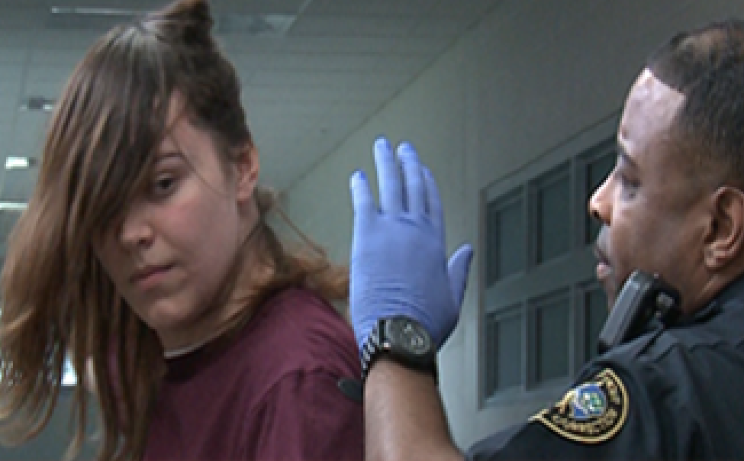
Considerations for Searching Transgender and Intersex Inmates and Residents

Slide 16
Term Definition
Transgender
A person whose gender identity is different from the person’s assigned sex at birth.

Slide 17
Term Definition
Gender Identity
Does not indicate sexual preference
A person’s internal, deeply felt sense of being male or female

Slide 18
Term Definition
Intersex
A person whose sexual or reproductive anatomy or chromosomal pattern does not seem to fit typical definitions of male or female.

