Slide 1
Module 6 First Response and Evidence Collection:
The Foundation for Successful Investigations
Notice of Federal Funding Disclaimer – This project was supported by Grant No. 2010-RP-BX-K001 and updated by Grant No. 2019-RP-BX-K002, awarded by the Bureau of Justice Assistance. The Bureau of Justice Assistance is a component of the Office of Justice Programs, which also includes the Bureau of Justice Statistics, the National Institute of Justice, the Office of Juvenile Justice and Delinquency Prevention, the Office for Victims of Crime, and the Office of Sex Offender Sentencing, Monitoring, Apprehending, Registering, and Tracking. Points of view or opinions in this document are those of the author and do not necessarily represent the official position or policies of the U.S. Department of Justice nor those of the National Council on Crime and Delinquency (NCCD), which administers the National PREA Resource Center through a cooperative agreement with the Bureau of Justice Assistance.

Slide 2
Module 6: Objectives
Describe the dynamics of sexual abuse and sexual harassment in confinement settings.
Identify best practice and policy requirements on first response procedures.
Identify best practice and policy requirements on evidence collection in confinement settings, per the requirements of 115.(3)34.

Slide 3
What are the Goals of an Investigation?
To determine the truth of the matter, through prompt and proper inquiry.
To provide safety and protection to both those who have been victimized and to society at large.
To properly and effectively acquire all types of evidence to meet the criteria for administrative action or prosecutorial referral.
To secure the appropriate sanctioning for individuals who violate policy and the conviction of criminally responsible offenders.

Slide 4
Types of Allegations
There are different types of allegations
Administrative:
Sexual Harassment
Sexual touching that may not be criminal
Criminal
Sexual Assault
All allegations must be investigated.

Slide 5
Continuum of Inmate-on-Inmate/Resident-on-Resident Sexual Abuse
Forced Sex
“Predators” Coercive Relationships
“Fatal Attractions”
&
Stalking
Sexual Intimidation and Pressure
Sexual Comments and Touching
Owen, B., Wells, J., Pollock, J., Muscat, B., & Torres, S. (2008). Gendered Violence and Safety: A Contextual Approach to Improving Security in Women's Facilities. Final report. Washington, DC: National Institute of Justice.
Notes:
The least serious form of sexual victimization described in the interviews was verbal, such as referring to another woman’s body or making sexual innuendos. Sexual “horseplay” or touching a woman’s body in a non-violent but uninvited and unwanted manner is also a relatively mild form of victimization.
This is followed by sexual intimidation which occurs when a woman is asked repeatedly to become involved romantically or sexually with another inmate. At first, most of our participants said that sexual intimidation was very rare. But, in further discussion, some women ventured that it was “hard to know” if women were coerced or entered into such relationships voluntarily.
A particular type of sexual pressure or intimidation occurs in so-called “fatal attraction” cases or “fatals” named after the movie of the same name that involved a stalker who would not give up her quest for a love interest. In these cases, one woman is enthralled with another and seeks a sexual liaison at any cost.
In some instances, women described certain individuals in the prison as “predators” in the same manner that the “booty bandits” exist in men’s prisons. These descriptions were not common, but they were mentioned.
At the more serious end of the coercion continuum, forced sex occurs. Most women had only heard of rapes or assaults in prison; very few had seen a rape personally. In most situations, women said the motivation for the sexual assault was unclear.
We did hear rare reports of sexual assault for retaliation for some personal, social or economic transgression. Most often, descriptions of sexual assault were presented as occurring in other prisons and jails or in the past. Most of these accounts had the character of stories or prison myths rather than first-person reports.

Slide 6
What is Reportable?
Everything is Reportable
But not everything is a PREA incident
Familiarize yourself with the U.S. Department of Justice definitions of sexual abuse and sexual harassment and your state criminal statute definitions of sexual assault
Be aware when you are investigating whether something is a possible case of sexual harassment or sexual abuse, or whether it is a possible policy violation and doesn’t rise to criminal activity.
Notes:
Handout: definitions. Discuss.

Slide 7
Types of Investigations
Sexual Harassment
Difficult to determine either substantiated or unfounded
Can be a precursor to more abuse
Important to document the investigation
Report delivered to those who can protect inmates/residents
History can demonstrate the agency’s record of protecting offenders

Slide 8
Dynamics of Sexual Harassment
Sexual Harassment
May precede sexual abuse and is used to
test a target
demean others
overtly or subtly intimidate
challenge new inmates/residents or staff
threaten inmates/residents or staff who are perceived to be weaker
May be used
to move the alleged perpetrator
to retaliate against the alleged perpetrator

Slide 9
Types of Investigations
Inmate-on-Inmate or Resident-on-Resident Sexual Abuse
May involve
Physical force
Coercion, pressure
Includes voyeurism and exhibitionism, abusive touching, and penetration
Remember: Not all sexual interactions are abusive and not all physical interactions are sexual.

Slide 10
Dynamics of Sexual Abuse
Sexual abuse in custody…
Triggers new mental illnesses and exacerbates existing ones
Spreads infectious diseases
Increases health and mental health care expenditures

Slide 11
Dynamics of Incarceration
Predators look for means, opportunity, and vulnerability, selecting targets…
who are least able to defend themselves,
who may be less believed or believable, or
who are disliked or ostracized.
PREA Review Panel Testimony by Dr. Robert Dumond, November 2006 available at: https://www.ojp.gov/sites/g/files/xyckuh241/files/media/document/written-dumond.pdf
Notes:
11
Talking points:
Staff are often quick to dismiss allegations from an offender who has made false allegations in the past. But in fact, those offenders are more likely to be victimized, because perpetrators know they’re less likely to be believed.
Offenders aren’t the only ones who ostracize other offenders – staff can do it too. Staff should go out of their way to treat all offenders equally.

Slide 12
Video
Notes:
https://www.youtube.com/watch?v=QKbnWW-4K-A

Slide 13
Dynamics of Incarceration
In women’s and girl’s facilities, relationships and loyalty tend to be valued highly. Men’s and boy’s facility cultures value aggression and power.
Some see sexual aggression as a way to assert their power and control over others.
Being victimized and seeking help often are viewed as signs of weakness.

Slide 14
Dynamics of Incarceration
Aggressors typically employ one of several methods to control victims:
Force (physical assaults or threats of harm)
Entrapment or blackmail (for example, requiring debts to be repaid with sex, protection)
Pressure tactics (persuasion, bribes, use of alcohol and drugs)
Remember that coercion ≠ consent

Slide 15
Video
Notes:
https://www.youtube.com/watch?v=QKbnWW-4K-A

Slide 16
Dynamics of Incarceration
Anyone can be at risk, but offenders are more vulnerable if:
Young and inexperienced
First-time offenders/new to incarceration
Are not “tough” or “streetwise”
Have mental illnesses or developmental disabilities
Incarcerated for sexual violence against children or vulnerable adults

Slide 17
How I got Here
Predator, Sociopath
Smart, Manipulative
Illegal Alien
Gang Attachment
No Education
Survival

Slide 18
Pathways for Women and Girls
Greater risk for experiences such as sexual abuse, sexual assault, and domestic violence
Women and girls in custody are 3 times more likely to have a history of abuse than men or boys in custody
BJS data, 1994: 43.2% of females reported experiencing physical/sexual abuse prior to incarceration versus 12.2% of males
Girls in custody have rates of abuse that are 6-10x higher than girls in the general population
Women with an abuse history are more likely than women with no prior abuse to be incarcerated for a violent offense (42% versus 25%)
The Context of Sexual Violence in Facilities for Women and Girls: Presented by B. Owen, 2007
Pollock, J. (2002), Women, Prison and Crime (2nd ed.). New York, NY: Wadsworth.
Notes:
Pollock, J. (2002), Women, Prison and Crime (2nd ed.). New York, NY: Wadsworth.

Slide 19
Pathways for Women
The Implications for these Backgrounds for Sexual Abuse in Female Facilities Include:
Sex defined as “love” or as a commodity
Boundary issues
Challenges in defining domestic violence
Fears about disclosure and reporting
PTSD and re-traumatization
Crisis and long-term treatment issue

Slide 20
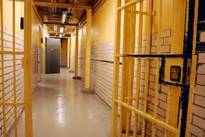
Protective Pairing
Protective Pairing or ‘HOOKING UP’ – an offender may trade sex for protection
Does this constitute CONSENT?
Does his/her survival depend on it?
Would the individual behave in this manner in the ‘free world’?
Notes:
Was same sex sexual abuse a piece of survival on the street?
Was there a institutionalized male in your life as a child

Slide 21
Continuum of Staff Sexual Misconduct
Love and seduction,
Inappropriate Comments
Sexual Requests
“Flashing”, voyeurism and touching
Abuse of search authority
Sexual Exchange, Sexual Intimidation
Sex without physical Violence
Physical Violence and Sex
Owen, B., Wells, J., Pollock, J., Muscat, B., & Torres, S. (2008). Gendered Violence and Safety: A Contextual Approach to Improving Security in Women's Facilities. Final report. Washington, DC: National Institute of Justice.
Notes:
With respect to abuse of search authority, in some locations, male officers are prohibited from patting down female inmates unless it is an emergency. In other locations, there are no such restrictions. What became clear to us, however, was that female inmates were just as likely to feel victimized by female officers who abused their power of physically searching. It may not be the gender of the officer that is the central issue in abuse of search authority, but, rather, training and management in order to ensure that the power is not abused.
With respect to sexual exchanges, many women in prison and jail have had lives where sexual victimization and inappropriate sexualization occurred very early in life. Thus, it is not surprising that they may exchange the offer of sex to get what they feel they need in a prison. Here is an example:
One cup of coffee can get (an officer) whatever they want in here. The men and female officers know that and they use that to manipulate and degrade us.
With respect to sexual intimidation, women expressed the view that they would do whatever they needed to not get moved to less desirable prisons or not to be given a disciplinary “ticket” or write-up, as suggested in this comments:
We put up with the abuse because we don’t want to move to [another facility]. If the price of staying here is to get down on my knees, then I will get my knee pads.
With respect to sex without physical violence, as women have little power to object, differentiating between consensual and non-consensual sex in the prison environment has little utility. Many women told us that they cannot refuse these advances because of their powerless position. We also learned that there are some women in prisons and jails who enjoy sex with men and are willing participants in a sexual relationship.
We heard very few stories of officers or other staff members physically forcing a woman to have sex. We could not determine whether this was due to the rarity of the event or the focus group methodology we used to collect these accounts.
With respect to abuse of search authority, in some locations, male officers are prohibited from patting down female inmates unless it is an emergency. In other locations, there are no such restrictions. What became clear to us, however, was that female inmates were just as likely to feel victimized by female officers who abused their power of physically searching. It may not be the gender of the officer that is the central issue in abuse of search authority, but, rather, training and management in order to ensure that the power is not abused.
With respect to sexual exchanges, many women in prison and jail have had lives where sexual victimization and inappropriate sexualization occurred very early in life. Thus, it is not surprising that they may exchange the offer of sex to get what they feel they need in a prison. Here is an example:
One cup of coffee can get (an officer) whatever they want in here. The men and female officers know that and they use that to manipulate and degrade us.
With respect to sexual intimidation, women expressed the view that they would do whatever they needed to not get moved to less desirable prisons or not to be given a disciplinary “ticket” or write-up, as suggested in this comments:
We put up with the abuse because we don’t want to move to [another facility]. If the price of staying here is to get down on my knees, then I will get my knee pads.
With respect to sex without physical violence, as women have little power to object, differentiating between consensual and non-consensual sex in the prison environment has little utility. Many women told us that they cannot refuse these advances because of their powerless position. We also learned that there are some women in prisons and jails who enjoy sex with men and are willing participants in a sexual relationship.
We heard very few stories of officers or other staff members physically forcing a woman to have sex. We could not determine whether this was due to the rarity of the event or the focus group methodology we used to collect these accounts.

Slide 22
Staff Offenders: Always an Unequal Relationship
Staff control the lives, freedom and safety of the offenders under their supervision
Staff can place offenders at risk with other offenders, can write disciplinary infractions, can compromise safety
Staff and offenders can NEVER be in an equal relationship
It is a ‘strict liability’ issue –
Consent is never an excuse
Notes:
Letter one

Slide 23
Video
Notes:
Play the video scenario where offenders discuss their experiences with staff sexual misconduct.

Slide 24
Staff and Offenders: Always an Unequal Relationship
How does the male staff affect the female in the video?
How does her past make her a vulnerable person?
Does she have the self esteem to get out of the relationship?
Does she deserve to be “loved by a good man”?
Notes:
How many of you have worked with, talked to, dealt with prostitutes on the street?
How many of you understand the choices they make?

Slide 25
Reports of Sexual Abuse and Sexual Harassment: Where do they come from?
Not every offender involved in a sexual abuse or sexual harassment incident identifies themselves as a victim.
In many cases, particularly those involving “staff member on offender” sexual abuse, the youth/adult victim involved may resist the investigation and refuse to cooperate.
Inmates/residents may have strong emotional feelings towards the involved staff member.
Inmates/residents may fear retribution from other inmates/residents, from the staff member or his/her co-workers.
Emotional/relational responses are not unusual.

Slide 26
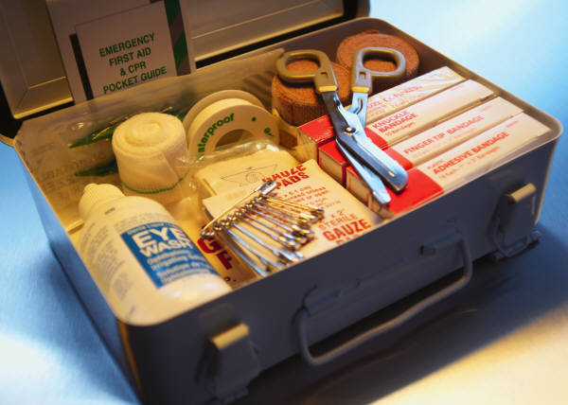
First Response

Slide 27
Video: First Responder
Notes:
Play the video embedded into this slide.

Slide 28
What is the Role of a First Responder
Important first step in the investigation.
Not an investigator.
Stabilizes the situation:
for the victim
for the facility
Supports the investigation by
securing the scene, if appropriate.
relaying important observations and information to the investigator.

Slide 29
INSERT APPROPRIATE POLICY HERE
INSERT AGENCY POLICY RE: FIRST RESPONSE HERE
What are the responsibilities of a first responder?
How does an allegation reach the investigator?
Include policy statements addressing what types of allegations are investigated.
Notes:
Who has what role

Slide 30
The Event is Reported
A first responder can be anyone.
Whomever an offender chooses to tell is the first responder
You have no control if the person reported to is not within the agency

Slide 31
Reports of Sexual Abuse and Sexual Harassment: Where do they come from?
From the offender (victim) directly.
From family of victims.
From other offenders.
From correctional staff.
From medical staff.
From mental health staff.
From other support staff.
From volunteers.
From advocates.

Slide 32
First Responder’s Role: Interacting with the Victim
Non-criminal allegations
Report, report, report!!
Ensure reporter understands the allegation is and will be taken seriously
Non-criminal incidents of sexual harassment and sexual abuse are often precursors to criminal incidents of sexual assault
Notes:
Make sure your agency has a process in place to report and deal with Sexual Harassment!

Slide 33
First Responder’s Role: Interacting with the Victim
Criminal Allegations
PREA Standard 115.64 requires a first responder to:
(1) Separate the alleged victim and abuser;
(2) Preserve and protect any crime scene;
(3) Request that the alleged victim and ensure that the alleged abuser not take any actions that could destroy physical evidence, including, as appropriate,
washing,
brushing teeth,
changing clothes,
urinating,
defecating,
smoking,
drinking, or
eating
Notes:
At a minimum the first responder should have general information about these things. An investigator or case manager can get more in depth a little later
Ensure safety without being condescending
Only contact family if there is a well thought out need to know. Do not assume of force a victim to contact family!

Slide 34
First Responder’s Role: Interacting with the Victim
Criminal Allegations
Ensure
Victim’s safety
Provision of medical assistance
Explain
Required housing changes
Basic investigative process
Importance of FME and evidence collection
Detailed, truthful interviews
If desired by victim or required by policy, contact support services or family members/friends.
Notes:
At a minimum the first responder should have general information about these things. An investigator or case manager can get more in depth a little later
Ensure safety without being condescending
Only contact family if there is a well thought out need to know. Do not assume of force a victim to contact family!

Slide 35
First Responder’s Role: Interacting with the Victim
The first responder will attempt to gather essential information
Description of suspect offender, clothing, or conduct.
Description of abuse or harassment for the investigator.
Description of location and scope of scene, if applicable.

Slide 36
First Responder’s Role: Interacting with the Victim
The first responder should NOT:
Conduct an in-depth interview with the alleged victim
Attempt to determine the validity of the allegation
Attempt to determine if the victim had any previous history or previous contact with the suspect
Attempt to determine background information on victim, including disclosure of consented sexual activity around time of abuse

Slide 37
What Should a First Responder Record in their Notes for the Report?
Detailed Description of Victim and Suspect
Locations
Affect (Real not surmised or assumed)
Wounds and where they are

Slide 38
What Does Every Case Need To Be Successful?

Slide 39
What Every Case Needs
Evidence sufficient to prove each element of the offense for administrative action or prosecutorial referral.
Identification of the suspect.
Cooperative victim.
Ideally, independent sources of corroboration of victim’s statements (these can be both forensic evidence and/or statements from others.)
Notes:
Most prosecuting attorneys will not pursue a criminal case without a cooperative victim
Elaborate on corroboration

Slide 40
What Every Case Needs
Remember – many of the steps for administrative investigations and criminal investigations are the same!
Standard 115.71 requires
Administrative investigation:
Interviews
Evidence collection
Criminal investigation
Interviews
Evidence collection

Slide 41
What is Evidence?
Something that can be used as proof of innocence or guilt.
Can include:
A verbal statement.
A document.
A material object.

Slide 42
What Are Your Sources Of Evidence?
Notes:
Make sure these are included in your policy.

Slide 43
Sources of Evidence
From victim: These include statements, forensic medical exam and physical evidence.
From abuse scene and any secondary scenes (cells, bathrooms, dayrooms, rec. yards, etc.) These include any physical evidence and area canvases.
From witnesses: These include those observing both pre and post abuse/harassment conduct, and those who may have insight into influencing factors, e.g. debts between offenders, etc.
From suspect: These include statements (both positive and negative) as well as any physical evidence (from clothing and body of suspect).

Slide 44
Sources of Evidence
Offender phones
Offender mail
Security video
Log books
Staff personal phones
Court orders, search warrants
Notes:
Take advantage of the correctional environment!

Slide 45
Credibility Assessment
115.71: Credibility Assessment
Camera footage
History of allegations
History of vulnerability
History of other relevant requests (attempts to move, etc.)
Relationship with suspect
Perceptions of staff
Recent discipline, moves, etc.

Slide 46
Sexual Harassment Cases - Considerations
Similar to “keep separate” system of investigating (e.g. bullying, threats, protection)
History of
unit moves under duress
behavior, staff perceptions
keep separates
manipulative behavior
relationships with staff
gambling or protection behaviors
discipline
retaliation
Relationship with suspect (e.g. friend, enemy, rival gang member, no relationship)

Slide 47
Pat-down Search Cases - Considerations
Who is conducing the search?
New officer
Seasoned officer
Agency’s pat search policy
Camera footage
Relevant history – possibility of retaliation?
Victim description and imitation of search
Officer description and imitation of search

Slide 48
Acquaintance Cases- Considerations
Evidence of force or coercion, if applicable.
Evidence of victim’s fear of assailant or of resistance.
Evidence of injury, if applicable.
Evidence of interaction between parties (demeanor or conduct.)
Evidence of communication such as letters, notes, etc.

Slide 49
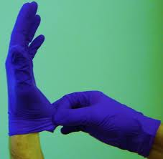
In the event of a sexual assault… GLOVE UP!

Slide 50
Facility Crime Scene
Video and photograph the crime scene area.
Identify staff who will touch and/or handle evidence.

Slide 51
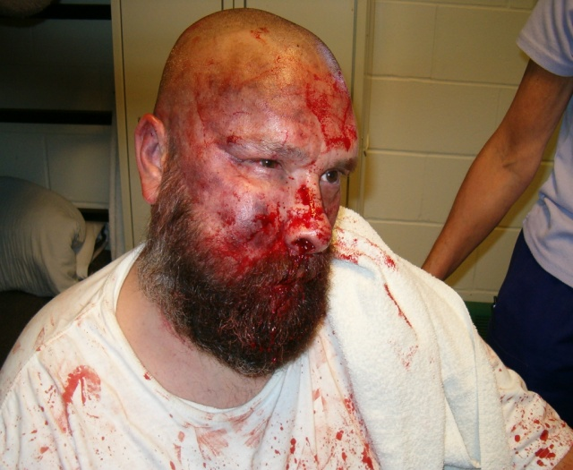
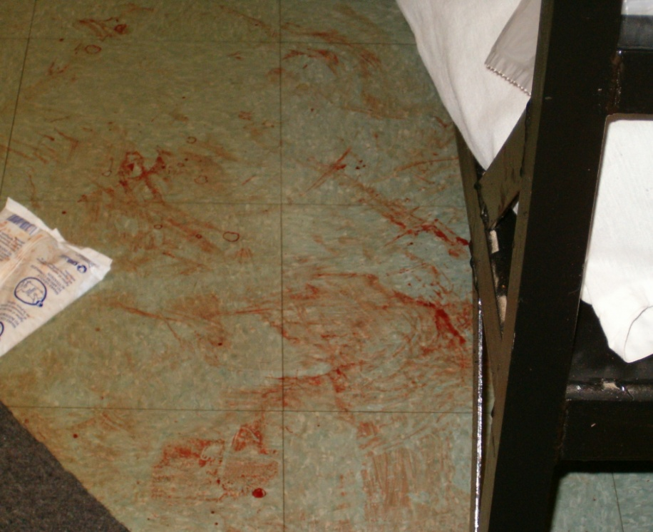
Crime Scenes
CRIME SCENE
VICTIM
SUSPECT

Slide 52
Sources of DNA
Blood
Saliva (skin cells)
Sweat (skin cells) “touch DNA”
Hair Root
Mucous
Vaginal Fluid
Semen
Vomit
Feces

Slide 53
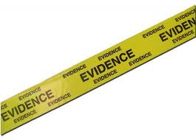
Physical Evidence to Collect From the Scene
Victim’s Underwear
Victim’s Clothes
Rug/floor covering
Chair covering
Towel
Blanket and sheets
Condom
Tissue
Other

Slide 54
Sexual Assault Evidence Kit
What happens during the process?
How long does it take?
How private should it be?
What needs to be done before the inmate/youth is taken to the hospital?

Slide 55
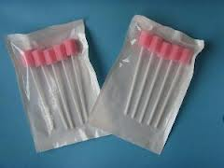
Evidence Collected by SANE
Oral swabs (if oral sex)
Vaginal swabs
Inner Thighs/Genitalia Swabs
Rectal Swabs
Blood Sample
Pubic Hair Combings
Pulled Head Hair (known samples)
Pulled Pubic Hair (known samples)

Slide 56
Physical Evidence to Collect From the Suspect
Underwear/Clothing
Penile Swab
Buccal Swab (as evidence of oral sex or as known sample)
Pulled Head Hair
Pulled Pubic Hair

Slide 57
Assessment of Forensic Exam
Cannot conclude
Validity of claim
“Diagnosis” rape/sexual assault
Degree of force
Can conclude
Recent sexual contact
Recent trauma
Consistency between findings and victim’s account of events
The absence of injuries does not mean that sex was consensual or a sexual assault did not occur.

Slide 58
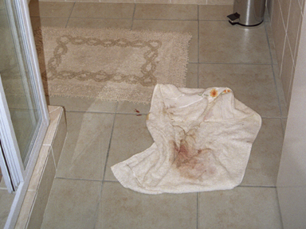
Physical Evidence to Collect From the Scene
Notes:
What would you collect here?
What else could you do here?

Slide 59
Processing the Crime Scene
Video
You can start the video as far back as the main door to the jail or prison.
Be very careful of what is said around the video.
If video stops for some reason note it in your report.
Video “out” and move your way “in.”

Slide 60
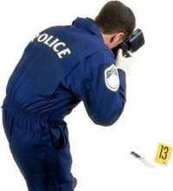
Processing the Crime Scene
Photography – Still
Photograph entire scene, start out and move in.
Keep a photo log to put with your report.
Do not delete photos that you think are substandard.

Slide 61
Processing the Crime Scene
Collection of Evidence
Determine if evidence is perishable.
Don’t play SHOW and TELL!!
Where do you put film or memory sticks?
Notes:
Bring containers
Video is evidence, no one not needing to know should have access
Use for training purposes comes after the prosecutor approves

Slide 62
Processing the Crime Scene
Preservation and Security
Place in evidence repository immediately.
Determine proper container for evidence.
Complete evidence log and sign.

Slide 63
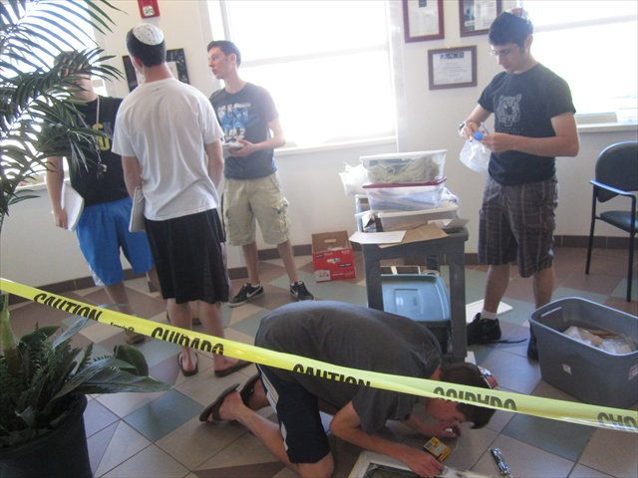
What is wrong with this photo?
Notes:
What is wrong with this scene
Too many people inside the scene

Slide 64
Hair - Take it or Leave it?
Notes:
How would you collect this if on the ground?
If on a sheet?
Hair
If attached or embedded in a moveable object, leave it intact and take entire item.
If not firmly attached, collect and place in a paper bindle, clean envelope, or small plastic bag.

Slide 65
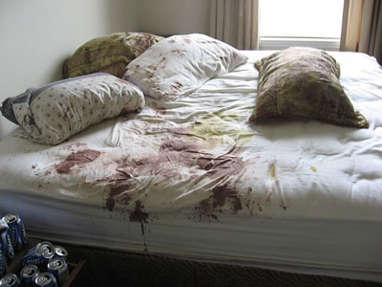
What are we bagging? How are we bagging it?
Notes:
How do you collect this?
What do you do if the sheets are severely blood soaked

Slide 66
Evidence Handling
Wet Items
Paper bag
Place paper bag in red biohazard bag
Transport to evidence locker
Open biohazard bag; roll down the side to expose the paper bag to the air

Slide 67
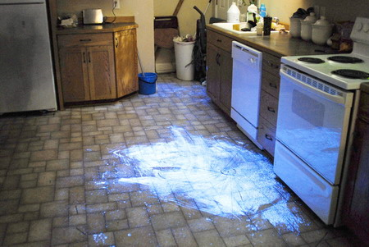
Use of Luminal
Notes:
Have you worked with Luminal
What would you do if this was carpet
Luminal shows bodily fluid does not tell you what or how old

Slide 68
Evidence Handling
Clothing
Keep articles of clothing separate.
Have paper below each item as it is being bagged to catch falling hair, lint or other evidence
NEVER place the clothing of a victim in the same container as those of the suspect.
Or in the washer!

Slide 69
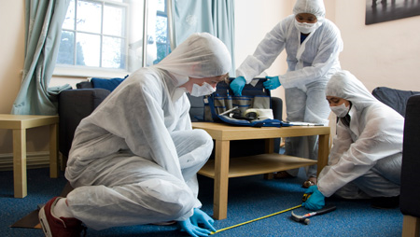
What would you take? How would you take it?
Notes:
Let’s say this is a manager’s office and the offender says she has been in this office twice and has had sex
What do you test?
What do you ask?
What do you take

Slide 70
Evidence Handling
Weapons
Take photos to record location of weapon(s) if you must move them
Document why you moved a weapon if it was moved before it was photographed.
Place in the proper container to ensure no one is harmed removing it from the evidence repository.

Slide 71
Evidence Handling
Other supportive evidence
Letters or notes between suspect and victim.
Gifts, favors, excess commissary, extra unexplained items, contraband.

Slide 72
Evidence
The value of physical evidence is that it…
Cannot lie, forget or change
Is demonstrable
Not dependent on witnesses
But once you have missed it, it is gone.
What is constructive possession?

Slide 73
Evidence
The value of physical evidence can be destroyed if:
Handled wrong
Moved too early
Marked incorrectly or inaccurately
Not preserved properly
Chain of custody is not precise

Slide 74
Crime Scene Mishaps
What do we do if the crime scene and/or evidence is mishandled?
You cannot put an item “back.”
You must explain what happened in your reports.
All staff involved must write reports.
Mistakes can be salvaged if dealt with honestly and not “covered up.”

Slide 75
Questions?

