Slide 1
Module 5: Role of Medical And Mental Health Practitioners in Investigations
Notice of Federal Funding and Federal Disclaimer – This project was supported by Grant No. 2010-RP-BX-K001 and updated by 2019-RP-BX-K002, awarded by the Bureau of Justice Assistance. The Bureau of Justice Assistance is a component of the Office of Justice Programs, which also includes the Bureau of Justice Statistics, the National Institute of Justice, the Office of Juvenile Justice and Delinquency Prevention, the Office for Victims of Crime, and the Office of Sex Offender Sentencing, Monitoring, Apprehending, Registering, and Tracking. Points of view or opinions in this document are those of the author and do not necessarily represent the official position or policies of the U.S. Department of Justice nor those of the National Council on Crime and Delinquency (NCCD), which administers the National PREA Resource Center through a cooperative agreement with the Bureau of Justice Assistance.

Slide 2
Module 5: Objectives
Understand the PREA Standards applicable to Medical and Mental Health Care practitioners involved in the investigative process
Describe the Forensic Medical Exam Process
Explain the Role of Victim Advocates

Slide 3
Evidence Protocol and Forensic Exams
§115.(3)21 Evidence protocol and forensic medical examinations
Follow a uniform evidence protocol that is developmentally appropriate and based on DOJ’s National Protocol for Sexual Assault Medical Forensic Exams, Adult/Adolescents*.
Offer all survivors access to exams, at no cost, when appropriate.
Exams must be performed by qualified medical professionals, such as Sexual Assault Nurse Examiners.
*A National Protocol for Sexual Assault Medical Forensic Examinations, Adults/Adolescents is available at: https://www.ncjrs.gov/pdffiles1/ovw/241903.pdf

Slide 4
Evidence Protocol and Forensic Exams – Access to Advocates
§115.(3)21(d) Evidence protocol and forensic medical examinations
Attempt to make available a victim advocate from a rape crisis center (RCC) to provide accompaniment.
If RCC is not available, qualified staff from community organization or agency staff must accompany survivors.
Document efforts to secure services from RCCs.
Can use advocates from government agencies if they are not affiliated with the criminal justice system and provide a comparable level of confidentiality as nongovernmental agencies.

Slide 5
Exam Evidence Protocol and Forensic Exams – Access to Advocates
§115.(3)21(e-h) Evidence protocol and forensic medical examinations
Advocates accompany and support victims through the exam process and investigative interviews and provide emotional support, crisis intervention, information, and referrals.
A qualified agency staff member must be screened for appropriateness and receive education on sexual assault and forensic exams.

Slide 6
Specialized Training
§115.(3)35(a) Specialized training: Medical and mental health care
Ensure medical and mental health staff are trained in:
How to detect and assess for signs of sexual abuse and harassment
How to preserve physical evidence of sexual abuse
How to respond professionally to victims
How and to whom to report allegations or suspicions of sexual abuse or harassment

Slide 7
Specialized Training, Cont.
§115.(3)35(b-d) Specialized training: Medical and mental health care
Medical staff who perform forensic examinations must receive appropriate training.
Maintain documentation of medical and mental health staff participation in required trainings.
Ensure medical and mental health staff receive appropriate staff, volunteer, or contractor training, in addition to the specialized training described above.

Slide 8
Access to Outside Confidential Services
§115.(3)53(a-b) Inmate/resident access to outside confidential support services
Provide inmates/residents with phone and mail access to rape crisis and/or other victim advocates.
Enable reasonable communication in as confidential a manner as possible.
Inform inmates/residents of the extent to which this communication is monitored and reports will be filed in accordance with mandatory reporting laws.

Slide 9
Access to Outside Confidential Services - Agreements
§115.(3)53(c) Inmate/resident access to outside confidential support services
Enter into written agreements (MOUs) with outside victim advocates who are able to provide inmates/victims with confidential emotional support.
Document attempts to enter into such agreements.

Slide 10
Coordinated Response
§115.(3)65 Coordinated response
Develop a written institutional plan to coordinate actions taken among first-responders, medical and mental health staff, investigators, and administrators.

Slide 11
Access to Emergency Medical and Mental Health Care
§115.(3)82(a-b) Access to emergency medical and mental health services
Provide timely, unimpeded access to emergency medical treatment and crisis intervention services.
If no practitioners are available, first responders protect victims and notify appropriate staff.
Notes:
In particular, the first responder is responsible to ensure that these interventions are provided to inmate survivors. However, for investigators to know the services offered to survivors following a report is important. Appropriate delivery of services will build trust between the survivor and the agency, which may lead to more reporting and greater honesty in interviews. Similarly, informative answers to survivors’ questions regarding emergency care will aid in relationship-building.

Slide 12
Access to Emergency Medical and Mental Health Care
§115.(3)82(c-d) Access to emergency medical and mental health services
Offer victims information about and timely access to emergency contraception and sexually transmitted infections prophylaxis.
Treatment must be provided at no cost to the victim, regardless of whether or not the victim cooperates with the investigation or names the abuser(s).
Notes:
In particular, the first responder is responsible to ensure that these interventions are provided to inmate survivors. However, for investigators to know the services offered to survivors following a report is important. Appropriate delivery of services will build trust between the survivor and the agency, which may lead to more reporting and greater honesty in interviews. Similarly, informative answers to survivors’ questions regarding emergency care will aid in relationship-building.

Slide 13
Access to Ongoing Medical and Mental Health Care
§115.83(a-b) Ongoing medical and mental health care for sexual abuse victims and abusers
Offer evaluation and treatment to inmates/residents who have been sexually abused, including:
Follow-up services
Treatment plans
Referrals for continued care
Notes:
Since the investigator will have contact with both the victim and the perp (if identified), the investigator should be sure to make the appropriate notifications of the persons within the agency who are responsible for medical and mental health interventions.

Slide 14
Access to Ongoing Medical and Mental Health Care, Cont.
§115.(3)83(c-d) Ongoing medical and mental health care for sexual abuse victims and abusers
Provide medical and mental health services consistent with the community level of care, including:
Pregnancy tests for victims of sexually abusive vaginal penetration
Timely and comprehensive information and medical care for victims who become pregnant as a result of abuse
Tests for sexually transmitted infections

Slide 15
Access to Ongoing Medical and Mental Health Care, Cont.
§115.(3)83(c-d) Ongoing medical and mental health care for sexual abuse victims and abusers
Provide treatment at no cost and regardless of whether the inmate names the abuse or cooperates in the investigation.
Within 60 days of learning of an inmate/resident previously perpetrated sexual abuse, prison mental health staff:
Conduct a mental health evaluation
Offer treatment, when appropriate
Notes:
Since the investigator will have contact with both the victim and the prep (if identified), the investigator should be sure to make the appropriate notifications of the persons within the agency who are responsible for medical and mental health interventions.

Slide 16
Interpreting the Medical and Mental Health Standards
Corrections must offer victims of sexual abuse:
Hospital accompaniment by an advocate
Emergency and ongoing medical and mental health care
Forensic evidence collection, as appropriate
Preventive measures such as pregnancy and HIV/AIDS tests and prophylaxis

Slide 17
Interpreting the Victim Services Standards
Corrections must:
Provide care in a trauma-informed manner
Develop an institutional coordinated response plan
Enter formal agreements with victim advocates and other service providers
Use a uniform evidence protocol to collect the most usable physical evidence

Slide 18
The Forensic Medical Examination

Slide 19
Sexual Assault Nurse Examiner
A Sexual Assault Nurse Examiner is a Registered Nurse who has been specially trained to provide comprehensive care to sexual abuse patients; who demonstrates competency in conducting a medical forensic examination; and has the ability to be an expert witness.

Slide 20
Forensic Medical Examination
A sexual assault medical forensic examination is performed by specially trained medical professionals for the purpose of:
Evaluation and treatment of trauma
Collection of evidence following a report of sexual abuse by a victim
Treatment of possible exposure to sexually transmitted infections
Referral to counseling and follow-up medical care
Notes:
A forensic medical examination is a medico-legal physical examination. There are a couple of goals of the exam the first is to provide interventions that improve the physical and mental health and well-being of sexual assault survivors – by decreasing the acute and long term effects of the assault and returning the victim to their previous functioning state. Secondly it is to retrieve evidence to support an allegation of sexual assault for future prosecution. The examination, collection of evidence and documentation of injury may be necessary either to substantiate an allegation or to help strengthen a case.

Slide 21
Medical Examination for Sexual Abuse Victim
If reported within 96 hours:
a medical examination of the victim of the sexual abuse for use in the investigation or prosecution of the offense may be requested
Notes:
A patient always has the choice to have an exam or not.

Slide 22
Dual Purpose of the Forensic Exam
Provide victim-centered care Address the needs of inmate(s) /residents who report sexual abuse | Investigations Gather evidence to assist the criminal justice process
The medical well-being of the patient is the primary objective of the SANE at all times during the examination.

Slide 23
Restraints should not restrict!
Recommended guidelines for retrieval of evidence on incarcerated survivors are NO different from the national protocol for sexual abuse victims.
Notes:
The Prison Rape Elimination Act of 2003 recommends that medical services provided to incarcerated victims should be no less than the care received by a victim in any health care facility/setting.

Slide 24
Victim Adaptations
Age
Gender/gender identity
Disabilities
Culture, ethnicity, religion
Sexual orientation
Victimization history
Abuse by an authority figure
Coping – support available
Consent/assent for exam
Notes:
The examination is adapted as necessary to address the needs and circumstances of the victim; whether its’ physical or psychological. It is evident that certain offenders are targeted for sexual assault the moment they enter the institution - regardless of age, mental health issues, physical attributes, disability, or sexual preference.
It is important to avoid making assumptions about the victim and the assault. Discussions with the victim should be framed in such a way that does not assume they are of a specific background. We need to try and understand their circumstances and tailor the exam process to address their needs and concerns.

Slide 25
What does a sexual assault forensic medical examination entail?
Collect medical forensic history from the patient
Head-to-toe examination to look for signs of trauma
Detailed Ano-Genital Exam to assess for trauma
Collection of forensic evidence
Notes:
Because medical and security activity can threaten one’s boundaries, it is important to prepare them prior to beginning any procedure. This also aids in restoring their physiological and emotional sense of predictability and control over what’s happening.
Once consent is obtained from the patient, a medical history is taken to determine injuries and appropriate medical treatment for the patient. The next step is a head-to-toe examination, including the ano-genital area, in order for the SANE to document trauma to any part of the body. Last, a collection of forensic evidence is done.

Slide 26
First Steps
Step 1:
Affidavit – Giving Consent
Patient Information
Step 2a:
History of Assault
Step 2b:
Medical History
Notes:
Once it has been decided that a sexual assault kit will be utilized – the seals are broken and the kit opened. This is the first step in the chain-of-custody.
Step 1: The victim (or guardian) MUST give consent for this examination. In extenuating circumstances where consent cannot be obtained (such unconsciousness or impairment) a next-of-kin may be contacted for consent (with witnesses) and/or a court-order may be necessary.
Step 2a: History of assault. A more detailed description of the assault. The “who, what, when, where, how” of forensics. Was the perpetrator known? Was there threats? Did the victim fight? Did ejaculation occur? What positions were they forced into? Any area where biological evidence may be found.
Edmond Locards’ Principle of forensics: “With contact between two items, there will be an exchange”
That’s what we’re after; the exchange…the evidence. Our forensic field: the victims’ body
Step 2b: A complete medical history of the victim. This includes: past surgeries/injuries; pregnancies; and any existing conditions or communicable diseases.

Slide 27
Step 3: Clothing Collection
Notes:
A head-to-toe assessment is completed on all exposed areas of the body to get as much evidence as possible prior to having the victim disrobe. All injuries are documented: type (such as bruises, lacerations/cuts, abrasions, scratches, etc.), location, size (measurement of injury in length & width) and color; and a collection of any foreign debris/object not normally found on the body (such as: grass, twigs, sand, dirt Once the head-to-toe assessment is completed and any evidence found has been collected, the victim is asked to stand on a paper sheet provided in the kit and disrobe. Clothing is removed and placed upon the paper sheet. Once undressed, the victim is provided a sheet & assisted onto the exam table and/or chair. The clothing is examined for any tears, stains, or blood. If any are found, they are marked appropriately. Each article is bagged separately in paper bags and labeled with identifiers, along with the date & time of examination/collection.

Slide 28
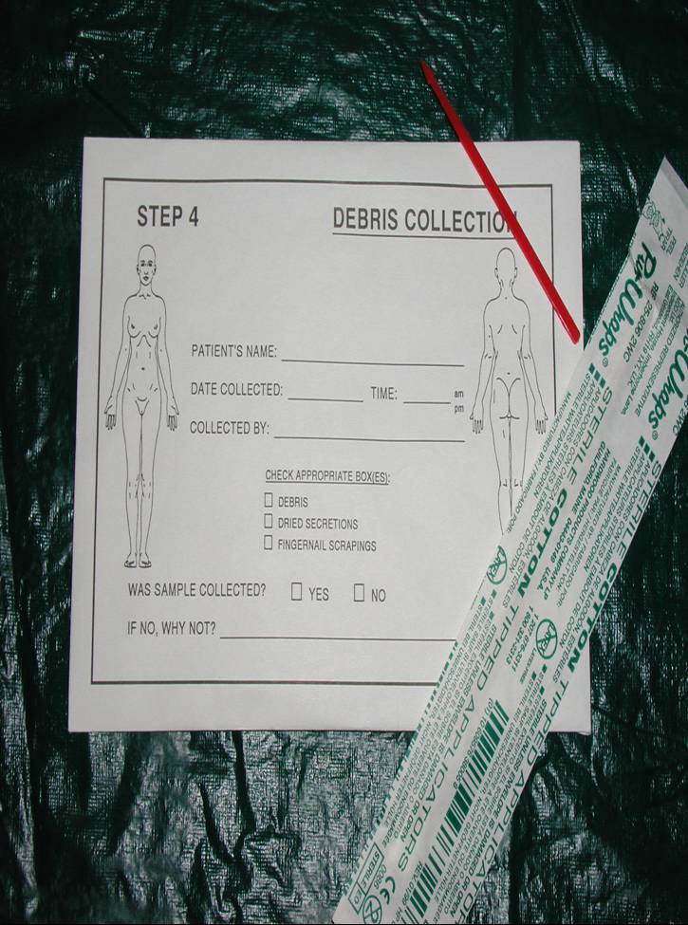
Step 4: Debris Collection
Notes:
Once the victim has disrobed, any foreign objects that are found on the body during the examination will be placed in this envelope. If fingernail scrapings and clippings are obtained, each hand is done separately and labeled accordingly.

Slide 29
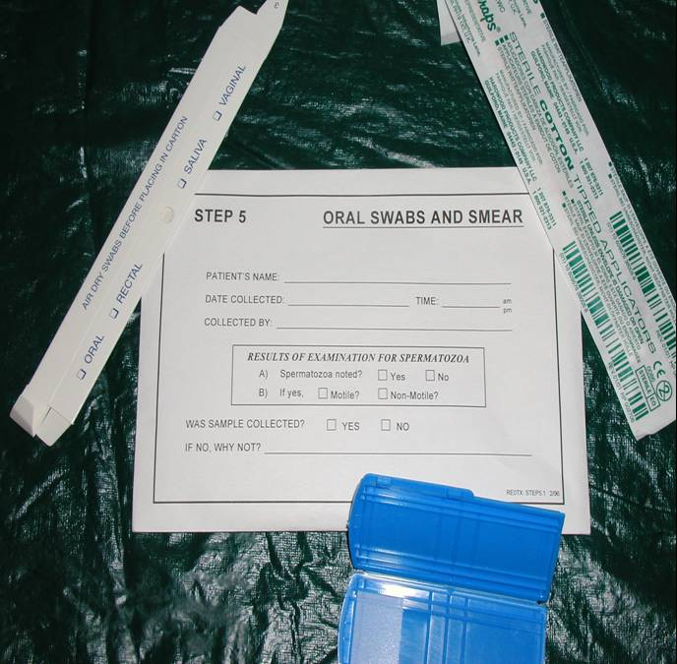
Step 5: Oral Swabs & Smears
Notes:
After oral inspection and documentation of injuries, swabs are obtained for DNA and ACP (prostatic acid phosphatase which is found naturally in both men and women – with higher concentration found in semen). Swabs are done by briskly rubbing the inside of both cheeks (buccal area) for several seconds then a smear is made on the glass slide for microscopic examination. Oral swabs can be just as important as vaginal or rectal swabs.

Slide 30
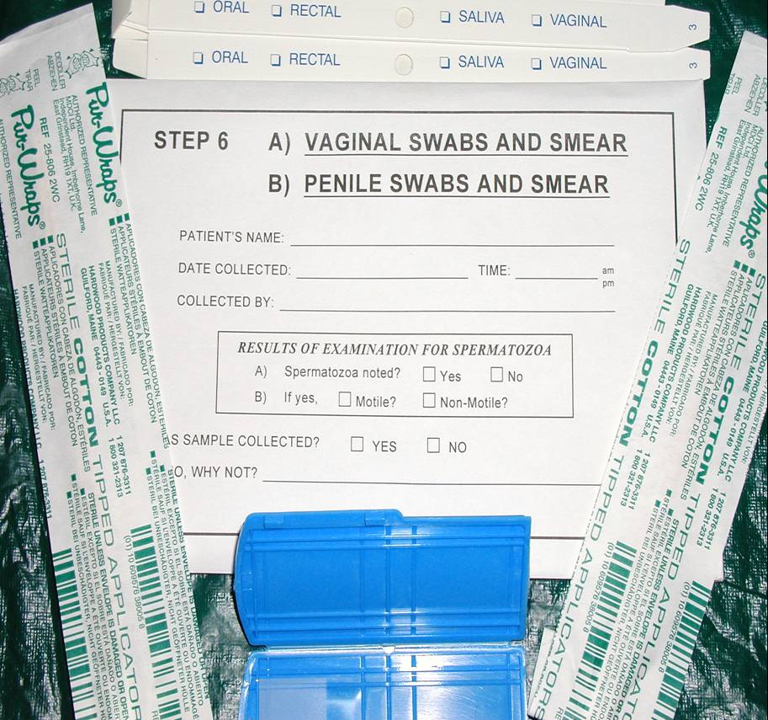
Step 6A: Vaginal Swabs & Smears Step 6B: Penile Swabs & Smears
Notes:
A detailed genital trauma assessment is performed. Inspection of the genitalia prior to collection of evidence is of utmost importance in order to note any injuries and to document all findings on the appropriate diagram.
For the male victim, the presence of saliva on the penis could indicate that oral-genital contact was made; feces or lubricant (such as saliva, grease, oil, etc.) may be found if rectal penetration occurred.

Slide 31
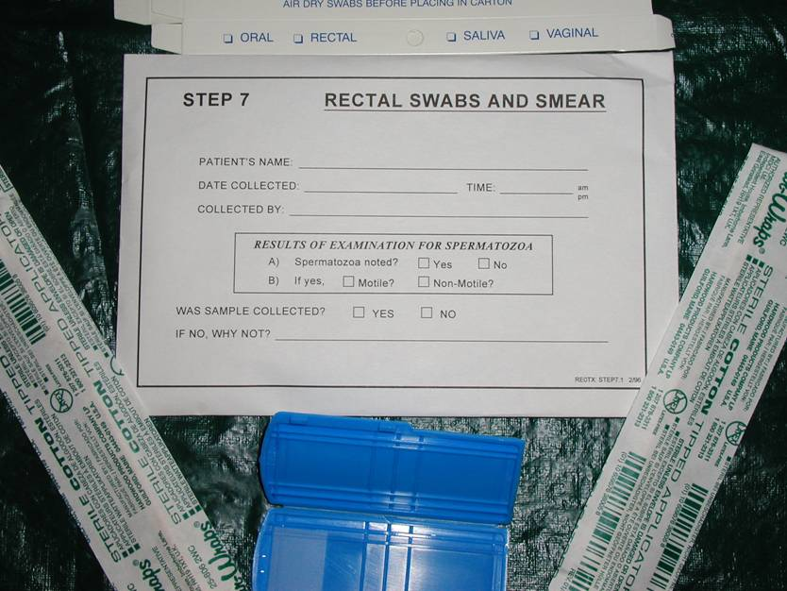
Step 7: Rectal Swab & Smear
Notes:
Note any/all injuries. Document tears, bruising, etc., color, measurement in centimeters and location. Swabs are obtained from around and in the anal opening and a smear is made on the glass slide.

Slide 32
Step 8: Head Hair Combings
Notes:
During assault, hairs may be transferred from one individual to the person or clothing of another. These hairs can be microscopically compared to known hair samples from both victim and suspect to determine the origin.
Head and pubic hair are the only hairs on the body that have enough individual characteristics for analysis. Delaying the collection of hair samples of the victim may adversely affect comparisons.

Slide 33
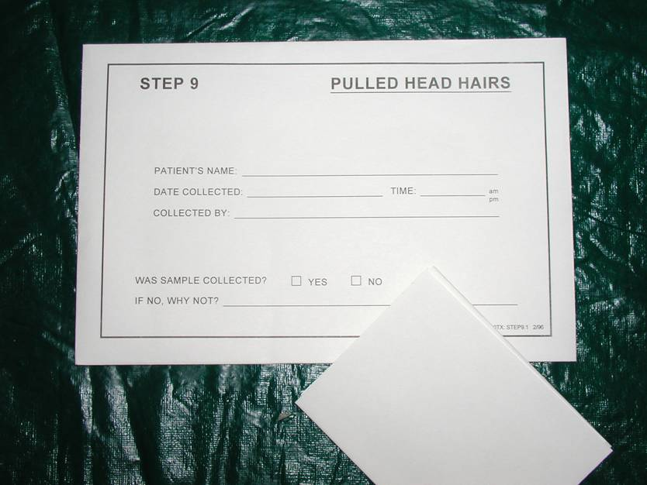
Step 9: Pulled Head Hairs

Slide 34
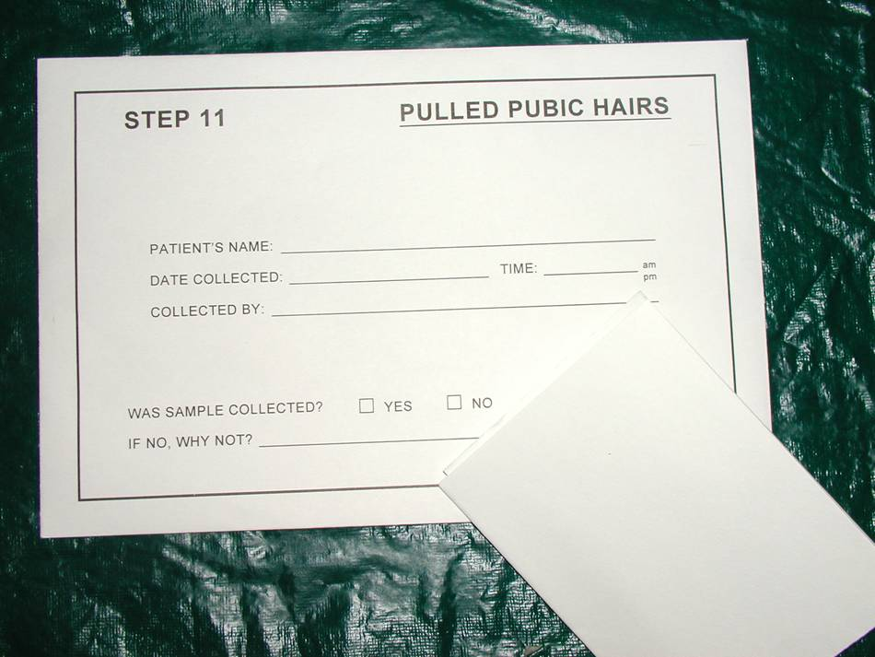
Step 10: Pubic Hair Combings Step 11: Pulled Pubic Hair
Notes:
Biological evidence (such as: blood, semen, saliva) may be found in the matted hair.

Slide 35
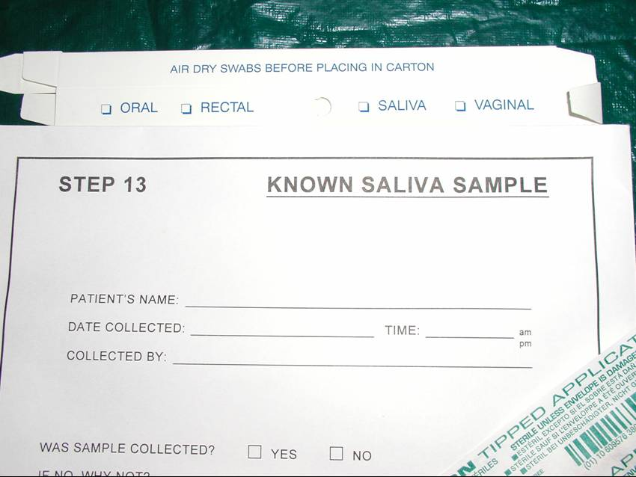
Step 12: Saliva Sample
Notes:
Saliva can also be used for ABO blood typing of the attacker. About 80% of individuals can be genetically typed from this marker.

Slide 36
Final Steps
Police evidence seals are affixed where indicated, dated & initialed by examiner.
ALL requested information if filled out.
Offer prophylaxis for sexually transmitted infections and pregnancy, if necessary
Provide discharge instructions and referrals
Notes:
Ensuring that all envelopes, boxes, slides, blood tubes, paper bags, etc. are properly labeled and tape securely, the evidence is placed into the box and the box is sealed. Once sealed, it cannot be re-opened.
Tampering with Evidence is a felony!

Slide 37
Documentation
Notes:
Step 14: This page includes the male & female anatomy and all injuries are documented on the appropriate chart.
Step 15: This is the victims information sheet.
Included are:
medications and/or treatment that were given and/or ordered
contact information for follow-up care; including their practitioner and mental health services

Slide 38
Remember!
It is important to always remember that the absence of injuries does not mean that sex was consensual or that the sexual abuse did not occur.
Notes:
The presence or absence of physical evidence does not prove whether a person has been sexually abused. Rather, the examination may provide supportive evidence to be used during legal proceedings. Documentation is a form of communication to other professionals working on the case. One must be able to define in a case hearing every word that is documented!

Slide 39
Access to Victim Advocates
Survivors need and deserve access to rape crisis services.
PREA standards require agencies to attempt to make a victim advocate available to survivors.
Access to advocates may also be required by federal and state laws.
Members of JDI’s Survivor Council in Washington, DC
Notes:
Sexual abuse in jail takes a considerable toll on survivors, their loved ones, detention facilities, and the community.
Inmate survivors need and deserve rape crisis advocacy services.
Victim service programs may be the only available support in rural areas.

Slide 40
The Rape Crisis Model
Survivor-centered
Goal is empowerment
Focus on managing immediate trauma symptoms and assisting the survivor to regain control and to heal
A problem-solving, non-directive approach

Slide 41
The Role of the Victim Advocate
A victim advocate can:
Accompany survivors through the response process, including the forensic exam and investigation
Provide survivors with crisis intervention and ongoing support
Serve as a source of information about the process
Associate Warden, Victim Advocate, and former Investigative Lieutenant (Left to Right) at California Correctional Institution, Tehachapi.

Slide 42
Importance of Victim Advocates
Sole focus is on survivors’ safety and well-being
Can maintain confidentiality
Available at any time - typically 24 hours/day
JDI Survivor Council member Frank Mendoza talking with an advocate.

Slide 43
Rape Crisis Services
Acute
Care
Follow-Up
Care
Longer-Term Care
Crisis Intervention
Short-Term Counseling
Counseling Referrals
Hospital Accompaniment
Legal Advocacy
Groups
Psycho-Educational Approach
Opportunities
for Activism
Safety Planning

Slide 44
Role of the Advocate During the Forensic Exam
Accompany survivors during the exam process.
Provide emotional support and information.
Advocate a survivor’s comfort and privacy during the exam.
Inform the survivor of his or her rights regarding the medical forensic exam.
Notes:
Be informed and open-minded.
Align yourself with the survivor.
Inform the survivor of his/her rights.
Negotiate the survivors’ privacy and comfort during the interviews and exam.
Have a back-up plan.
Prepare the survivor to return to jail.

Slide 45
Role of the Advocate in Investigative Interviews
Accompany survivors during interviews.
Provide emotional support and information regarding the investigative process.
Will not participate in the interview or serve as a translator.
Assist the survivor to address his or her needs during the interview, such as taking a break, when needed.

Slide 46
Role of the Advocate in Providing Ongoing Care
May be able to provide follow-up services via phone, by mail, or in-person
Can assist survivors’ in their healing to manage the long-term impact of trauma and to participate in the investigative process
Services are usually free and confidential

Slide 47
Victim Advocates and Confidentiality
In some states, advocates are legally required to keep client information confidential.
They may be bound by professional ethics and legal standards of licensing bodies.
Advocates cannot disclose information, including names of perpetrators to the facility.
Advocates give survivors the tools they need to make their own decisions.

Slide 48
The Benefits of Advocates
Advocates reduce survivors’ trauma and improve investigations in the following ways:
Advocates increase survivors’ wellness and help them to cope with the trauma of the sexual abuse.
Survivors are likely to feel more comfortable with the investigation if they have an advocate.
Survivors who feel comfortable and supported are more likely to participate in the investigative process, which increases the likelihood of a successful investigation.

Slide 49
Questions?

