Slide 1

Module 2:
Legal Issues and Agency Liability: What Investigators Should Know
Notice of Federal Funding Disclaimer – This project was supported by Grant No. 2010-RP-BX-K001 and updated by Grant No. 2019-RP-BX-K002, awarded by the Bureau of Justice Assistance. The Bureau of Justice Assistance is a component of the Office of Justice Programs, which also includes the Bureau of Justice Statistics, the National Institute of Justice, the Office of Juvenile Justice and Delinquency Prevention, the Office for Victims of Crime, and the Office of Sex Offender Sentencing, Monitoring, Apprehending, Registering, and Tracking. Points of view or opinions in this document are those of the author and do not necessarily represent the official position or policies of the U.S. Department of Justice nor those of the National Council on Crime and Delinquency (NCCD)Impact Justice (IJ), which administers the National PREA Resource Center through a cooperative agreement with the Bureau of Justice Assistance.
This module has been developed over many years and includes legal research and work provided by American University, Washington College of Law, and Jeff Shorba.

Slide 2

Module 2: Objectives
Identify the steps to take prevent or mitigate legal liability through the investigative process.
Understand the use of, and the difference between, Miranda and Garrity, as required by PREA standard 115.(3)34.
Apply an understanding of Miranda and Garrity to conducting successful investigations.

Slide 3

Miranda and Garrity

Slide 4

Notes:
http://www.youtube.com/watch?v=T45aF1NLMyM

Slide 5
Miranda v. Arizona (S.CT. 1966)
Stems from the Fifth Amendment against self-incrimination:
“The prosecution may not use statements….stemming from an interrogation of the defendant unless it demonstrates the use of procedural safeguards effective to secure the privilege against self incrimination….”

Slide 6
Miranda v. Arizona (S.CT. 1966)
If a person is in custody and being interrogated:
  They must be made aware of the fact that they have the right not to answer questions.

Slide 7
Berghuis v. Thompkins (S. Ct. 2010)
Shooting suspect mostly silent during three-hour interrogation
Asked if “he prayed to God to forgive him for the shooting.” Answered yes
  S. Ct. said statement could be used
Silence during interrogation does not invoke right to remain silent
Interrogation need not end until there is an “unambiguous” statement that you wish to remain silent

Slide 8
Miranda v. Arizona (S.CT. 1966)
A suspect must waive his/her rights:
  Voluntarily
  Knowingly
  Intelligently
  Unambiguously

Slide 9
Miranda
Are incarcerated offenders ever not in custody?
Can they ever choose to leave?
Under what conditions would they really have “freedom” to leave?

Slide 10
Howes v. Fields (S. Ct. 2012)
Michigan jail inmate questioned for 5-7 hours by armed deputies using a sharp tone and profanity
Told he was free to return to his cell but no Miranda warning
Court defined custody as “circumstances that are thought generally to present a serious danger of coercion”
People already in prison or jail unlikely to be coerced by a longing for prompt release and questioners lack authority to do so
Balance – told free to leave with length, hour and tone of the questioning

Slide 11
Miranda
Agency in collaboration with your prosecuting authorities will need to decide how to develop your own process
Most conservative approach is to provide Miranda warnings
Generally does not discourage inmate from talking and will provide the most protection
If not, will need to ensure documentation the inmate was free to leave and other conditions which would distinguish the situation from “custody”.

Slide 12
Garrity V. New Jersey
(S. CT. 1967)
Officers were threatened with termination if they would not testify to the fixing of tickets
The court held that this process of requiring officers to testify violated the constitution
Coerced testimony could not be used against them in criminal proceeding

Slide 13
Garrity
The warning will clearly inform the staff that his/her answers to questions will not be used against them in a criminal prosecution
Subject must be informed that refusing to give a statement (or failing to give a true statement) may be grounds for immediate termination of employment

Slide 14
Garrity: The Investigative Process
The burden of proof that the prosecutor did not use statements of the accused under Garrity is on the State.
The two cases must not mingle after interrogation of the suspect staff with Garrity warning

Slide 15
Garrity: The Investigative Process
Solutions
  Try a non-coerced staff suspect statement first
  If the suspect staff refuses to answer questions and your agency wants answers you must provide some type of Garrity warning

Slide 16


Garrity: The Investigative Process
It is important to let the criminal case pass into the charged state before the administrative investigator begins to interview the staff suspect

Slide 17
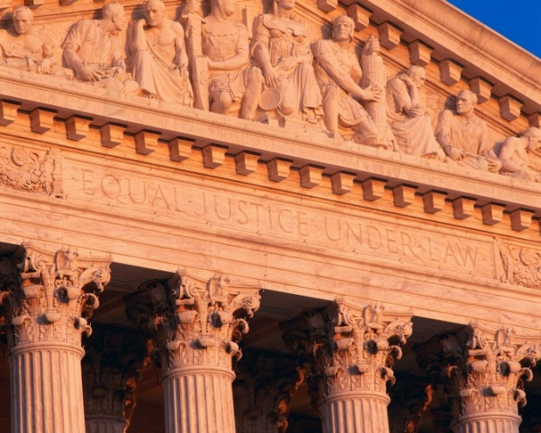
Court Approach
Courts are not prison administrators
Courts always have the benefit of hindsight
Litigation changes the landscape for decisions
Litigation brings other issues
Press coverage, etc.

Slide 18

What The Court Looks For
Prior Practice of the Department/Facility
  Have there been prior complaints?
  Who has raised them?
  Is there a policy? Consistently applied?
  Is there training? Mandatory? For whom?
  Was there a thorough investigation?
  Were appropriate actions taken? (Discipline, termination, etc.)

Slide 19

Staff Sexual Misconduct Criminal Laws
The climate has changed significantly in the last two decades
Similar to the current emphasis on PREA – staff sexual misconduct became significant issue in the early 1990’s
Problems arose due to major cases in several states

Slide 20
Staff Sexual Misconduct Criminal Laws
All 50 states, the federal government, and D.C. have laws specifically covering the sexual abuse of persons in custody
32 states cover community corrections agencies
29 cover juveniles explicitly – 17 implicitly

Slide 21
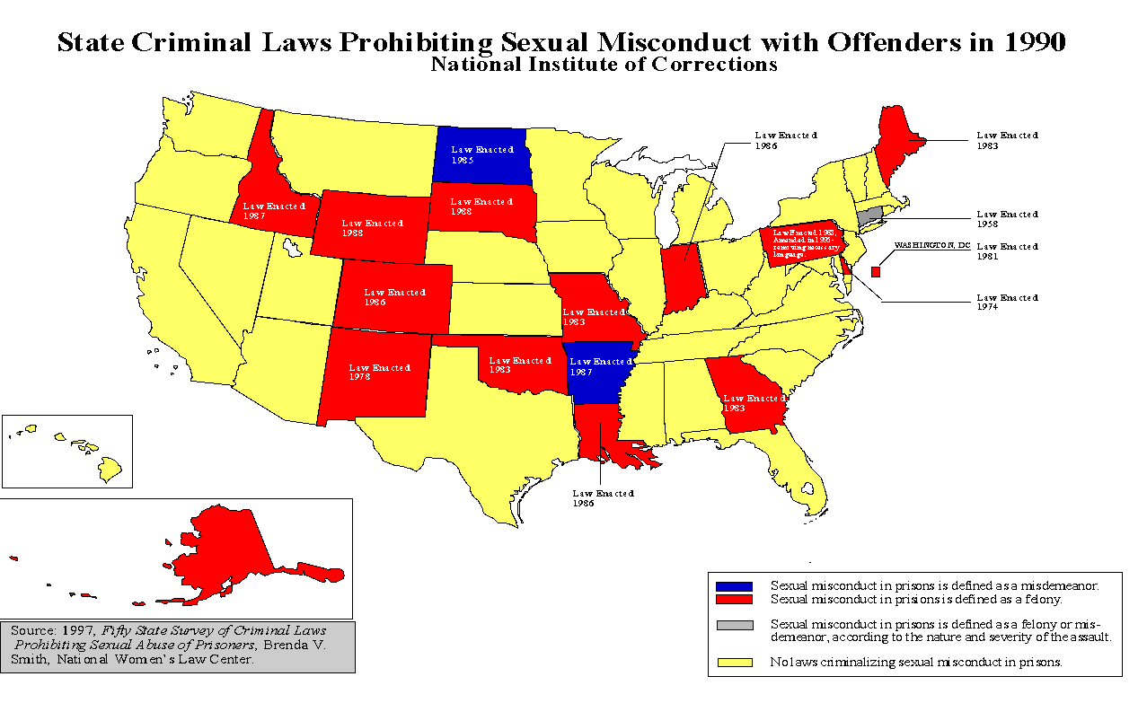
1990 State Laws Prohibiting Staff Sexual Abuse

Slide 22
2010 State Laws Prohibiting Staff Sexual Misconduct
Wash.
Vt.
N.H.
Montana
Me.
N.D.
Minn.
Mass.
Oregon
Wis.
Idaho
S. D.
Mich.
N.Y.
Ct.
RI
Wyoming
Iowa
Pa.
N.J.
Nevada
Neb.
Ill.
Ohio
D.C.
Utah
Colorado
In.
WV
Va.
Del.
California
Kansas
Mo.
Ky.
Md.
Tenn.
N.C.
Arizona
N. M.
Okla.
Ark.
S.C.
Ms.
Al.
Ga.
Texas
La.
Hawaii
Florida
Alaska
Sexual misconduct defined as a misdemeanor.
Sexual misconduct defined as a felony.
Sexual misconduct defined as either a felony or misdemeanor depending on the nature and severity of the assault.
No statute specifically criminalizes sexual misconduct.
Source: September 2005. Brenda V. Smith, The American University, Washington College of Law

Slide 23
States that Cover Community Corrections 2010
Vt.
N.H.
Wash.
Montana
Me.
N.D.
Minn.
Mass.
Oregon
Wis.
Idaho
S. D.
Mich.
N.Y.
Ct.
RI
Wyoming
Iowa
Pa.
N.J.
Nevada
Neb.
Ill.
Ohio
D.C.
Utah
Colorado
In.
WV
Va.
Del.
California
Kansas
Mo.
Ky.
Md.
Tenn.
N.C.
Arizona
N. M.
Okla.
Ark.
S.C.
Ms.
Al.
Ga.
Texas
La.
Hawaii
Florida
Alaska
Community Corrections covered under law
Not community corrections specific- general language used (i.e.: supervision”
Community Corrections specifically not covered
Community Corrections not mentioned by law
Source: September 2005. Brenda V. Smith, The American University, Washington College of Law

Slide 24
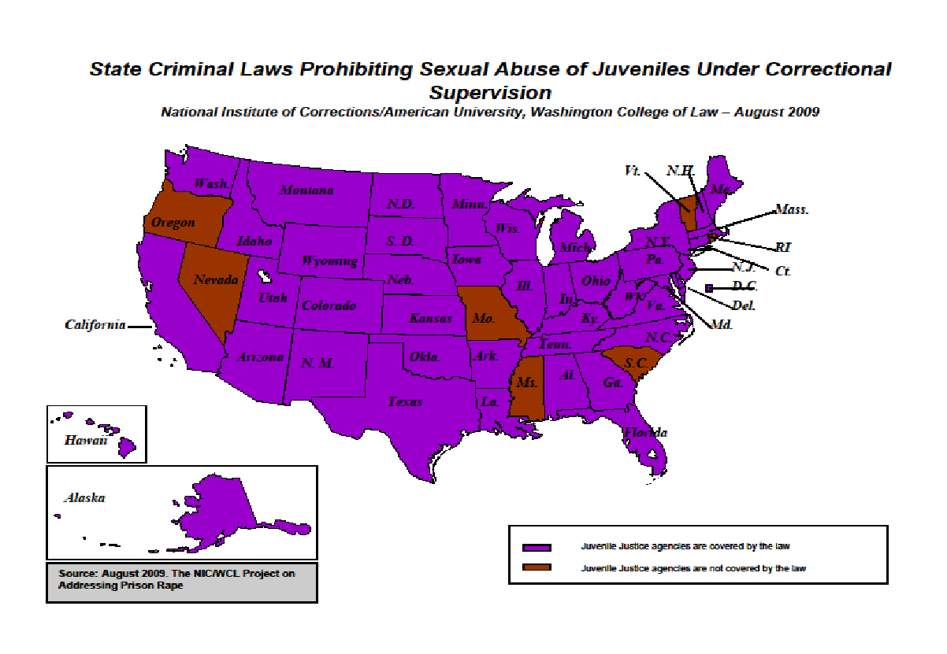
States that Cover Juvenile Justice Agencies
Vt.
N.H.
Wash.
Montana
Me.
N.D.
Minn.
Mass.
Oregon
Wis.
Idaho
S. D.
Mich.
N.Y.
Ct.
RI
Wyoming
Iowa
Pa.
N.J.
Nevada
Neb.
Ill.
Ohio
D.C.
Utah
Colorado
In.
WV
Va.
Del.
California
Kansas
Mo.
Ky.
Md.
Tenn.
N.C.
Arizona
N. M.
Okla.
Ark.
S.C.
Ms.
Al.
Ga.
Texas
La.
Hawaii
Florida
Alaska
Juvenile Justice agencies covered by the law
Juvenile Justice agencies not specifically covered (ie: under the offender’s care)
Juvenile Justice agencies not covered under the law
Source: September 2005. Brenda V. Smith, The American University, Washington College of Law
24

Slide 25
-INSERT SLIDE WITH THE LAWS OF THE STATE IN WHICH YOUR AGENCY/FACILITY IS LOCATED-

Slide 26
Other State Criminal Laws
Sexual Assault
Statutory Rape
Sodomy
Sex Offender Registration
  Adult and Juvenile
Vulnerable Adult Statutes
Licensing
Malfeasance in Office/Official Misconduct
Obstruction of Justice
Making False Statements to a Government Official
Mandatory Reporting

Slide 27
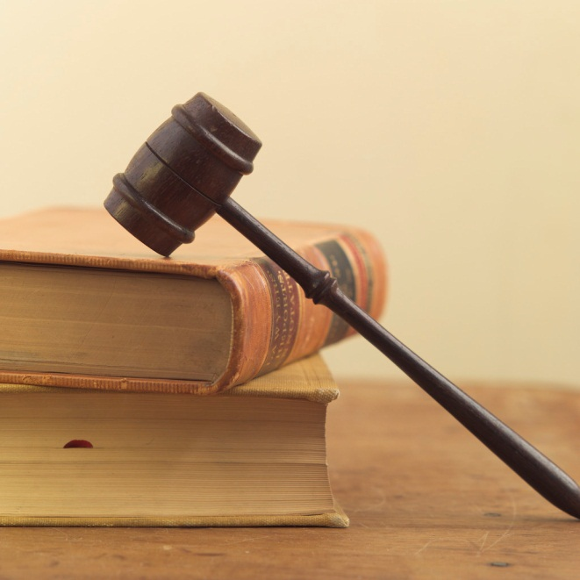
State Tort Law Claims
Assault
Battery
Intentional Infliction of Emotional Distress
Negligent Infliction of Emotional Distress
Negligent Hiring, Firing, Supervision

Slide 28
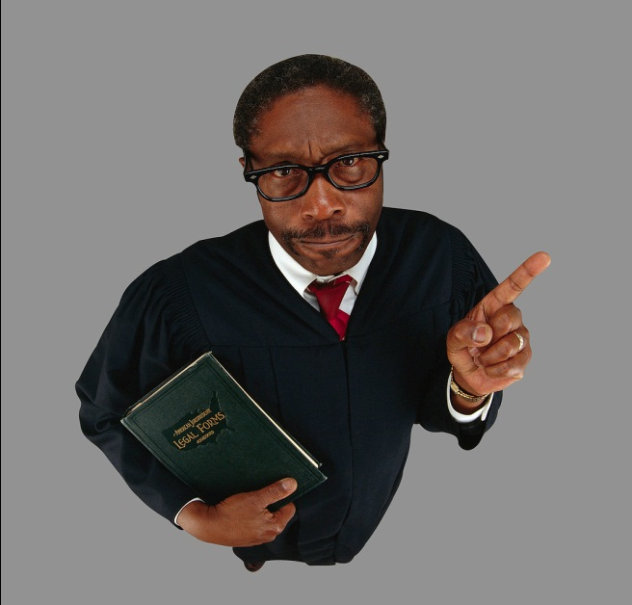
Litigation
Policy and practice are often developed in crisis
Being proactive now can help avoid crisis later
Taking the right steps in policy, procedure, practices and investigations will make litigation less likely and will make for more effective policies and procedures in the long run

Slide 29

PREA and Legal Issues
PREA does not create a separate cause of action. However, it will be used as justification in other lawsuits.
Byrd v. Maricopa County (9th Cir -1/5/11)
  Pretrial detainee in jail subjected to cross gender strip search
  Ninth Circuit found search violated 4th amendment rights
  Opinion cited the PREA Commission report and standards

Slide 30

Legal Framework
Creates a federal cause of action for the vindication of rights found elsewhere
42 USC. 1983
Key Elements
      Deprived of a right secured by the constitution or law of US
      Deprivation by a person acting under color of state law
      Don’t forget volunteers and contractors

Slide 31
Official Liability: 8th Amendment
Farmer v. Brennan, 511 US 825 (1994)
  Transsexual prisoner brought suit for injuries suffered when prison officials placed him in general prison population
  Established new legal standard with two part test:
  1. The injury must be objectively serious
  2. The official must have acted with deliberate indifference or reckless disregard for constitutional rights

Slide 32
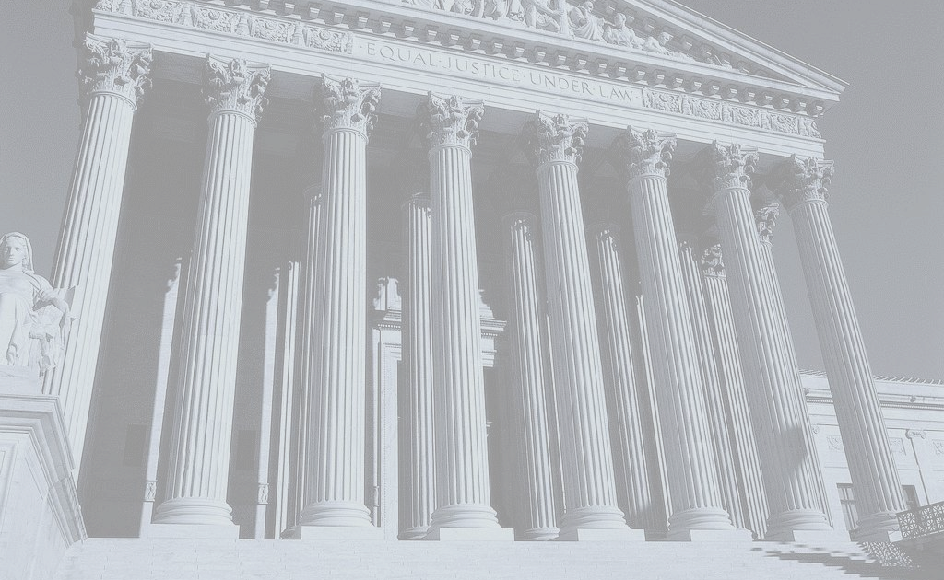
8th Amendment:
What the Court Looks For
Deliberate indifference to inmate vulnerability – safety or health
Official knew of and disregarded an excessive risk to inmate safety or health
Official must be aware of facts which would indicate a substantial risk of harm and the official drew that inference
Do not need to know of actual harm just risk

Slide 33



Legal Framework
Types of Liability
Two types of liability:
  Official
  Individual

Slide 34
Legal Framework
Official Liability
Did it happen on your watch?
Were you responsible for promulgating and/or enforcing policy?
Did you fail to act or ignore information presented to you?
Did it result in harm – proximate cause (as opposed to the direct cause)?

Slide 35
Legal Framework
Official Liability
Can Result From:
  Failure to train – ensure staff are aware of laws and policies
  Negligent supervision – oversight to ensure policies followed and complaints addressed
  Negligent employment or retention – take action if needed – failure to fire
  Best protection is proactive approach – courts will look to see what steps have been taken

Slide 36
Legal Framework
Official Liability – Policy is Not Enough
Daskalea v. DC (DC Cir. 2000)
Court ordered sexual misconduct policy could not insulate agency even though guard’s acts were against policy
  No training on policy
  Never gave policy to staff or inmates
  Policy not posted
  15 grievances by inmate resulted in no action
  No “supervision” by staff or cameras

Slide 37
Legal Framework
Individual Liability
Plaintiff must provide notice that the suit is against the official in her personal capacity
Direct participation not required
  Actual or constructive notice of unconstitutional practices
  Demonstrated gross negligence or deliberate indifference by failing to act
  Assumed knowledge of state law as correctional administrator
  Egregious behavior – but it can happen

Slide 38
Riley v. Olk-Long, 282 F.3rd 592 (8th Cir. 2002)
Inmate brought Eighth Amendment action against Warden (Olk-Long) and Director of Security (Sebek)
Alleged male staff had forced sexual relations with offender
Jury found corrections officials deliberately indifferent
Warden and Security Director found personally liable
  Warden ($25,000);
  Security Director ($20,000)

Slide 39
Riley v. Olk-Long – What Happened?
Officer made inappropriate comments to inmate regarding sex with roommate
Officer groped the inmate. She did not report it. Did not think she would be believed and feared discipline
Officer later entered inmate’s cell and raped her
Another inmate witnessed the incident and reported it
Inmate placed in administrative segregation during investigation
Officer terminated and convicted under state law

Slide 40
Riley v. Olk-Long
Why Personal Liability?
Why were Warden and Security Director held personally liable?
  Prior to this incident other female inmates had complained
  Officer had a history of predatory behavior
  Four prior investigations closed as inconclusive (sending $, sexual assaults, bus stop pick up, comment to inmate’s mother)
  Collective bargaining unit precluded permanent reassignment – put in control center for short time then put back
  Opportunity to terminate officer but did not

Slide 41
Riley v. Olk-Long – Court Decision
Court Decision
Found the Warden and Security Director were deliberately indifferent
Did not take the threat posed by the officer seriously
Collective bargaining agreement is not an excuse
Protecting the inmate is the duty of both correctional officials

Slide 42
Ortiz v. Jordan (S.Ct. 1/24/11)
Female reformatory inmate brought 4th and 8th amendment claims against a case manager and prison investigator
Alleges officer Schultz walked up to her in living quarters and grabbed breast – said he would “see her tomorrow”
Next day she reported it to case manager Jordan
Jordan said Schultz was reassigned to another facility and would be leaving the next day. Just wait it out.

Slide 43
Ortiz v. Jordan (S.Ct. 1/24/11)
Jordan wrote an incident report. In it she stated Ortiz would not name her assailant. Jordan did not notify her supervisor (she submitted the report two days later).
Later that day Ortiz was again sexually assaulted by Schultz. She reported it.
Investigator Bright assigned who began investigation two days later.
Bright placed Ortiz in solitary confinement. Ortiz claims this was retaliation for reporting.

Slide 44
Ortiz v. Jordan (S.Ct. 1/24/11)
Legal claims: Jordan did nothing to stop second assault and placement in solitary was retaliation
Case proceeded to trial. Jury returned a verdict for plaintiff
$350,000 in compensatory and punitive damages against Jordan
$275,000 against Bright
Case appealed on technical grounds - when can qualified immunity defense be raised

Slide 45
Gonzales v. Martinez, 403 F.3d 1179 (10th Cir. 2005)
Inmate alleged sexual assaults by jail administrator and officer (son-in-law of Sheriff)
Written statements provided by women to Sheriff
Sheriff delayed moving women from jail or moving officers
Both later convicted of assault

Slide 46
Gonzales v. Martinez –
Court Findings
Sheriff ignored complaints claiming inmates were being troublemakers
Rarely went to the jail and admitted administrator did not like investigations
Left women in custody of alleged assailants
Knowledge of risk does not have to be specific to one individual or one incident

Slide 47
Beers-Capitol v. Whetzel, 256 F.3d 120 (2001)
Residents of juvenile detention facility sexually assaulted brought 8th Amendment claim against supervisors and co-workers
No summary judgment for facility counselor on official or personal liability where:
      She told one of the plaintiffs she “kind of knew” employee was “messing” with residents
      Admitted in deposition she heard rumors employee was having sex with residents
      She did not investigate or report, but made file notes of the claims to “cover herself”

Slide 48
Guidry v. Rapides School Board, 560 So.2d 125 (La. App. 1990)
Action against residential training school
Co-ed group of mentally handicapped children required constant supervision
Staff took brief smoke break
Girl sexually assaulted by group of boys
Court held: School breached its duty of reasonable care by leaving students alone
Responsible for damage caused by male students

Slide 49
R.G. v. Koller (D. Hawaii 2006)
Lesbian, Gay and Transgender Youth sought preliminary injunction against secure juvenile facility
Court granted a preliminary injunction based on evidence of:
  Campaign of harassment based on sexual orientation including threats of violence, physical and sexual assault, social isolation and constant use of homophobic slurs

Slide 50
R.G. v. Koller
Supervisory staff knew of the harassment. Failed to take the following actions:
  Policies and training to protect LGBT youth;
  Adequate staffing and supervision;
  Functioning grievance system; and
  Classification system to protect vulnerable youth
System was also in discussions with DOJ to reach agreement on civil rights violations

Slide 51
Kahle v. Leonard (8th Cir. 2007)
On the job trainee supervised by senior officer in jail
After lockdown trainee entered inmate’s cell three times
Allegations of kissing, oral sex and genital contact – one visit lasting more than 5 minutes
Any entrance into cell was to be logged

Slide 52
Kahle v. Leonard (8th Cir. 2007)
Supervisor could be held liable for trainee behavior
Work station had lights indicating cell door was open
Testimony he could see cell from supervisor station
No logs of any entry into cell
No qualified immunity

Slide 53
Legal Framework
Qualified Immunity
Was the law governing the conduct clearly established?
Reasonable person test
Sepulveda v. Ramirez (9th Cir. 1992)
  Male officer observed female in stall during entire urinalysis process
  No qualified immunity. Observation was unconstitutional – n o reasonable officer could believe it was lawful
Similar result in staff sexual misconduct cases

Slide 54
Volunteer and Contractor Liability
Smith v. Cochran, 339 F.3d 1205 (2003)
  Inmate assigned to work in state driver’s license bureau as part of her sentence
  Supervised by non correctional officer
  Provided sex in exchange for favors (seeing brother at the job, gifts, trips to see family, etc.)
  Agency that is delegated the responsibility of the state can be liable under 8th amendment

Slide 55
Volunteer and Contractor Liability
Holding of the case has implications for anyone with authority over inmates
“Penological responsibilities” delegated (supervisory authority and job training)
Acting as agents of corrections
Have the ability to affect inmate conditions or release via discipline
Ensure mandatory training to avoid civil and criminal penalties

Slide 56
Investigative Process
False Arrest and Malicious Prosecution
Undercover operations
  Issues of consent
  Need to protect
  How is inmate treated following the investigation?
  What incentive is provided for participation in the investigation?

Slide 57
Investigative Process: Corona v. Lunn, 2002 WL 550963 (S.D.N.Y April 11, 2002)
Investigator Lunn assigned to review allegations of sexual misconduct
Receives information that Inmate Ross had sex with Officer Corona
Inmate initially denies
Inmate later admits to sex
Inmate has had history of mental illness

Slide 58
Investigative Process: Corona v. Lunn, 2002 WL 550963 (S.D.N.Y April 11, 2002)
Investigator takes statement
Investigator corroborated details of the encounter with records and review of facility
Files a felony complaint against Officer
Officer placed on administrative leave without pay
Officer charged with sexual assault of inmate
Acquitted after jury trial
Reinstated with back pay
Officer files suit for false arrest and malicious prosecution

Slide 59
Investigative Process Standards
False arrest – no probable cause to make allegations against Officer
Malicious Prosecution – commenced or continued a criminal proceeding without probable cause
Both probable cause issues. If probable cause is there for initial arrest something else must intervene to invalidate it for prosecution

Slide 60
Investigative Process: Corona v. Lunn, 2002 WL 550963 (S.D.N.Y April 11, 2002)
No false arrest because Lunn had probable cause.
  Could rely on informant testimony notwithstanding her psychiatric history
  Corroborated her testimony through review of facts
  Was objectively reasonable to believe that probable cause existed
  Reasonable officers could have disagreed over whether probable cause existed
Nothing happened with probable cause to suggest malicious prosecution

Slide 61
Sting Operations: Sanchez-Luna v. US (Dec. 2004)
Suspicion of female offender sexually abused by officer
Investigator sets up sting. Agent in closet with camera
Oral sex occurs with offender while agents record
No effort made to stop the act

Slide 62
Result of Litigation: Sanchez-Luna v. US (Dec. 2004)
Officer pleads guilty
Terminated from position
8th Amendment violation alleged
Settlement of $165,000 to plaintiff
When conducting operations – ensure you are in position to prevent or stop sexual conduct from occurring

Slide 63

Elements of Failure to Protect
Prison official knew that the inmate faced a substantial risk of serious harm
Disregarded risk by failing to take reasonable steps to abate the risk

Slide 64
Failure to Protect: Brown v. Scott, 329 F.Supp.2d 905 (E.D. Mich. 2004)
Inmate sued unit manager for not changing his cell assignment upon request
    Told unit manager that cellmate was predatory homosexual rapist
    Said he had been warned by other inmates
    Three days later forcibly raped

Slide 65
Failure to Protect: Brown v. Scott, 329 F.Supp.2d 905 (E.D. Mich. 2004)
Unit Manager’s Defense
  No record of cellmate as “designated” homosexual predator – past conviction
  Asked inmate if he had been solicited or threatened – answer was no
  Inmate only referred to rumor
  Didn’t specifically ask for protection just cell change
  Would have been placed in segregation if he had asked

Slide 66

Failure to Protect: Brown v. Scott, 329 F.Supp.2d 905 (E.D. Mich. 2004)
Court’s Decision
  Allowed the case to proceed – no summary judgment
  Evidence inmate was affiliated with group known for preying on other inmates
  Defendant on notice there was a high risk of assault
  Reasonable claim of 8th amendment violation

Slide 67

4th Amendment
The 4th Amendment
The right of the people to be secure in their persons, houses, papers, and effects, against unreasonable searches and seizures, shall not be violated, and no Warrants shall issue, but upon probable cause, supported by Oath or affirmation, and particularly describing the place to be searched, and the persons or things to be seized.

Slide 68

Privacy
Right to privacy is contextual
In corrections, what constitutes a “reasonable expectation of privacy” is different than in the community
Secure institutional settings vs. community corrections
Correction officers working in secure areas have low expectations of privacy

Slide 69
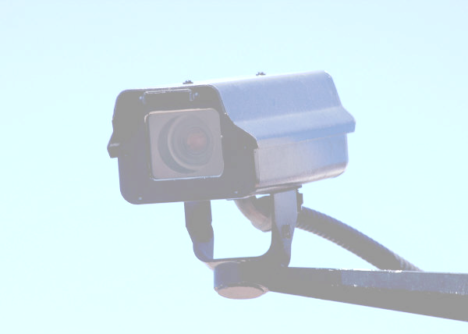
Surveillance
Notice—Is it posted and in policy?
Methods
Random vs. targeted surveillance
  Level of suspicion
  None, individualized or reasonable suspicion, probable cause
  Decision should be objective

Slide 70

Employee Surveillance
If you are going to use employee surveillance in investigations, think about:
Notice to employees
(e.g., that there are cameras present in the workplace)
Methods used
Random vs. targeted surveillance
Objective cause
Balance between intrusiveness and employer need

Slide 71
Lessons Learned: Liability
Corrections officials can and are held officially and personally liable
Liability stems from failure to:
  Train
  Supervise
  Investigate, and
  Discipline
Lawsuits are not just a legal issue but affect the reputation of an agency and the corrections profession

Slide 72
Lessons Learned: Liability
Examine patterns in your facility
Same officer accused many times may mean different things
Check many sources of information – medical, grievances, etc.
History of inconclusive investigative findings can be problematic
Lack of leadership – sometimes you have to take a risk

Slide 73

Activity: Scenario

Slide 74

Questions?

